Slide 2
Guide to migrate your .NET app to Azure
Hamida REBAÏ

Slide 3

Hamida REBAI
MVP in Developer Technologies
Software architect
Dotnetfoundation Member
Twitter: @rebaihamida
didourebai@gmail.com
https://www.linkedin.com/in/hamida-rebai-trabelsi-09b8525/

Slide 4
Agenda
Introduction
Migration analysis
Cloud Roadmap
App Modernisation with containers
Maturity Model for modernizing .NET applications
Deploying Azure Container Instance
Notes:
To accelerate a digital transformation, companies should build a strategy to move to the cloud and ensure a safe transition of their existing applications to the new approaches or prevent learning the new cloud patterns and architecture to build a new application.
During this session, we will discuss about the cloud adoption methodologies, tools, resources and the best practices to simplify and accelerate moving your current application to the cloud, , it is necessary to understand the assessment phase and adjustment needs, presentation and definition of Azure services, after we will present the different steps to migrate .NET apps to Azure and illustrate the advantage of a full range of cloud benefits like automatic scaling, patching, performance monitoring, and CI/CD. So you will be able after this session to know how you can move your existing .NET Framework applications directly to the cloud by modernizing specific areas, with or without re-architecting or recoding entire applications.

Slide 5
Introduction
Create the initial technical plans.
Ensure that your workloads will run as expected.
Prepare a qualitative model for estimating migration costs.
Perform the migration by limiting the impacts on the company
Notes:
Before you begin planning for a cloud migration, you need to define how:
- Create the initial technical plans. - Ensure that your workloads will run as expected. - Prepare a qualitative model for estimating migration costs. - Perform the migration by limiting the impacts on the company so this is experimentation phase

Slide 6

Migration analysis
Notes:
This phase is the most important part in your move to the cloud because you need to understand your environment, your infrastructure, your application, the security requirement, the governance, to be able to decide if you are ready to go to the cloud and the cost now and after 5 years for example. Every direction in the company should contribute to the analysis.

Slide 7
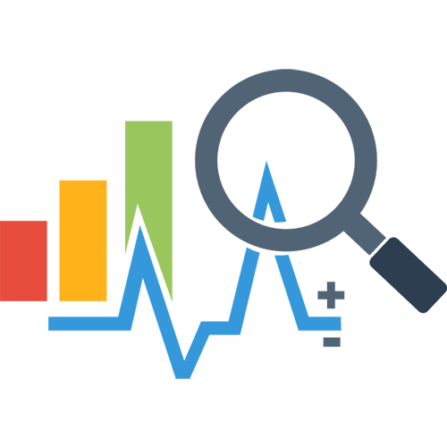
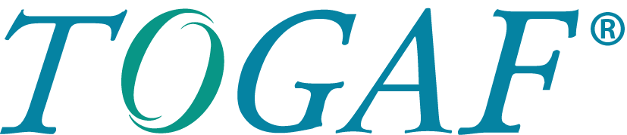
Migration analysis
The first phase of analysis may be based on a Vision of the Architecture Development Method (ADM) cycle of the Open Group Architecture Framework (TOGAF).
Notes:
The result of the first phase of the analysis is a vision architecture and to do that, some companies used TOGAF

Slide 8
TOGAF & ADM
“The TOGAF standard is a framework for Enterprise Architecture. It may be used freely by any organization wishing to develop an Enterprise Architecture for use within that organization”[1]
The TOGAF Architecture Development Method (ADM) forms the core of TOGAF.
"The Architecture Development Method (ADM) Cycle defines best practices for developing an organization's enterprise architecture.“
[1] https://pubs.opengroup.org/architecture/togaf9-doc/arch/
Notes:
So what is TOGAF? It is a framework used inside an organisation to develop an Entreprise architecture and TOGAF Architecture Development Method cycles defines the best practices to build an organization's enterprise architecture.

Slide 9
ADM
Build the technical architecture.
Plan the deployment.
Implement it.
Manage the changes.
Notes:
ADM consists of a preliminary phase followed by eight phases to:
Build the technical architecture.
Plan the deployment.
Implement it.
Manage the changes.

Slide 10

Cloud migration phases
Based on TOGAF, a cloud migration will contain six phases:
Identification of the source architecture
Identification of the target architecture
Identification of cloud solution providers.
Selection of one or more cloud providers.
Migration plan.
Migration and test.
Notes:
In any transformative change, it’s important to understand what the destination is and what the waypoints along the journey will be. There are multiple potential destinations for any application, and IT cloud deployments will be a mixture of them.

Slide 11

Cloud migration factors
The complexity of your infrastructure.
The skills of your team.
Stage of the application development cycle.
Information security levels
Notes:
The cloud migration strategy will depend on many factors:
- The complexity of your infrastructure.
- The skills of your team.
- Stage of the application development cycle: coupling and links between applications and databases
- Information security levels

Slide 12

Cloud migration principles
Go Fast
Push the boundaries ➔ Think “Experience”
Make data driven decisions
Simplify
Communicate to succeed: share, best practices.
Notes:
Go Fast : Fail fast, learn fast Try many, use best
Push the boundaries : Design new applications and capabilities for the cloud model Refactor legacy apps to take advantage of cloud capabilities Think “Experience”
Make data driven decisions Simplify : Manage your costs Use telemetry to gain insight into operational efficiency Understand your blockers Manage your plan-of-record
Simplify: This focuses on retiring, right-sizing, and consolidating as many services and applications as possible. Applications that are infrequently or rarely used often generate significant costs for an IT organization, with little return.
Communicate to succeed :Communicate customer and stakeholder impacts— transparency is key,
Share learnings and best practices

Slide 13

Cloud Roadmap Passage to the cloud
Notes:
Let’s prepare our cloud roadmap, we supposed that we have a vision architecture and we will start defining our strategy for every application according to our infrastructure and links between them.

Slide 14
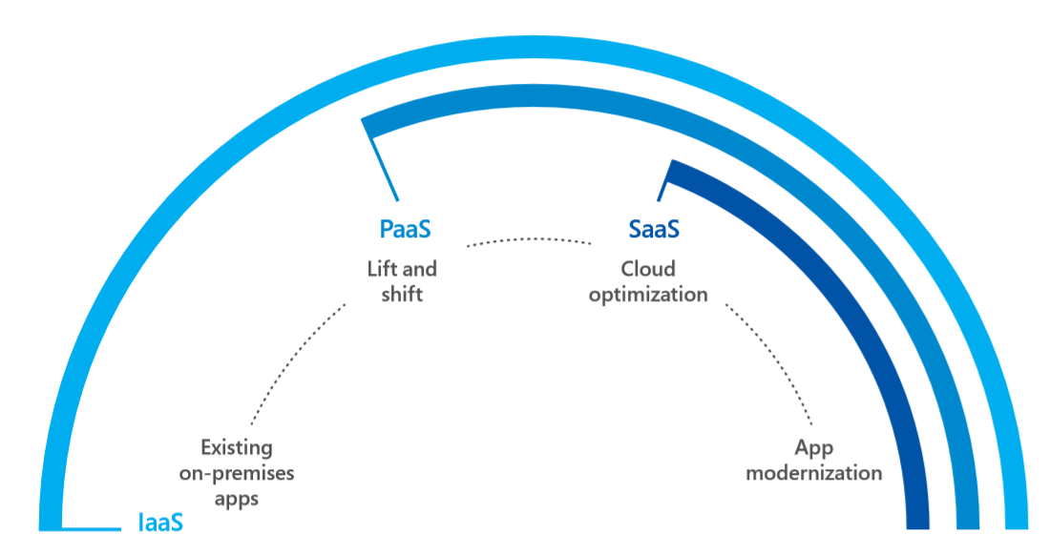
Cloud migration strategy
Migration strategies typically fall into one of four categories:
Notes:
In this picture, we can see the different strategy that we can use it for any application, if your analysis define that an application can’t move to the cloud for technical reason or data security issues, this application will stay on-premises, but, we have more strategies, the first one is the lift and shift, we talk about Infra as a Service, but to take advantages of the cloud, and minimise costs, we recommend to opt for Platform as a service and for same cases we can replace an application by another in the cloud, we talk about Software as a service.

Slide 15
The journey to the cloud
SaaS Apps
Serverless
Microservices
Rebuild
or New
Containers
Rearchitect
Refactoring
VMs
App Modernisation
On-premises infrastructures and applications
Apps
Data and AI
Infrastructure
Migration & Modernisation
Re-Host / Refactor / Rearchitect
Cloud – Native
Rebuild / New
SaaS
Replace
On-premises

Slide 16

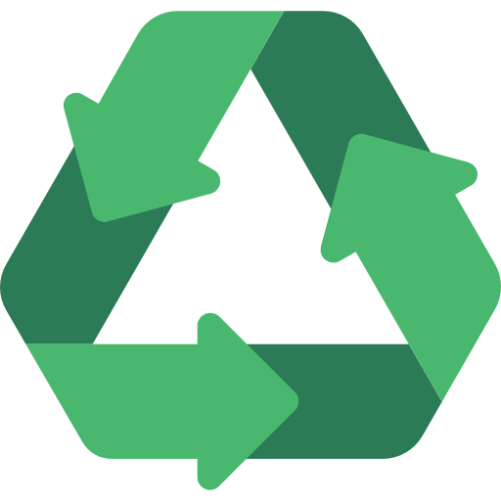
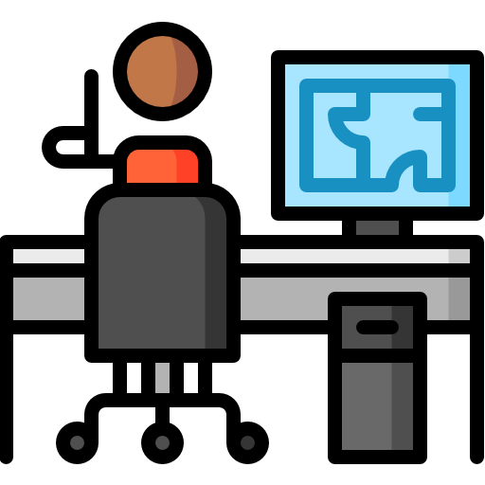

Cloud migration approaches
Applications
Data and AI
Infrastructure
Migration & Modernisation
Re-Host / Refactor / Rearchitect
Cloud – Native
Rebuild / New
SaaS
Replace
On-premises
DevOps: deliver faster and more reliably
<Re-host>
Migrate applications as they are to take advantage of the cloud without the risks or costs associated with code changes
<re-factoring>
Leverage infrastructure as a service (IaaS) and platform as a service (PaaS) without code change
<Re-architecting>
Upgrade your application to a resilient, highly scalable architecture that can be deployed independently.
<Rebuild>
Rebuild an application from scratch using native cloud technologies.
Notes:
After defining the priority, all members should study the data compliance and confidentiality, the technology used, to decide if we are able to move it without a change or load shedding for a redesign.
Because everything is around the applications, the choice on the strategy will depend on the migration way, we are talking here about the 5 R.
Technical professionals inside the company have to prepare an exit plan for every application, and the need to decide if they will work on all applications even if they can't be integrated into the cloud or select the application that they have to start a strategy.
The application can be:
Rehosted: lift and shift and extend strategy without any change
Refactor – is a repackaging of your app, but no major code changes
Rearchitect – modernizing your code, breaking monoliths into microservices
Revised Or RePlatformed: lift-tinker-and-shift introduced by Amazon AWS
Rebuilt: we need to discard legacy application and develop again using cloud services and features, it requires good mastery of a functional and technical concept, familiarity with an existing application and business processes as well as cloud services.
Replaced or RePurchase: it means that we will use a SaaS solution instead of current application.

Slide 17



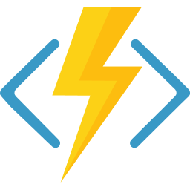
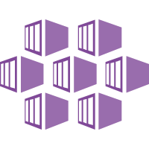
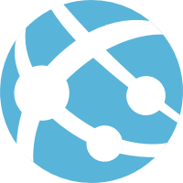
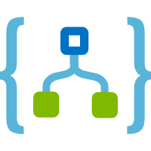
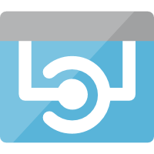
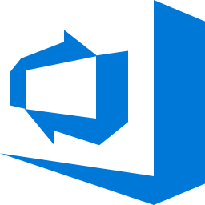
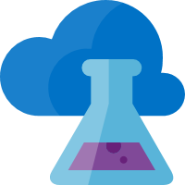
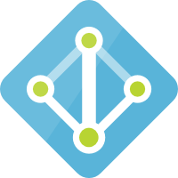
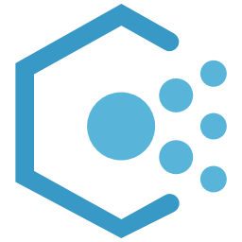
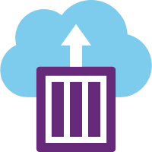
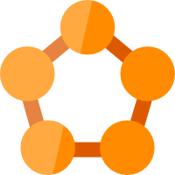




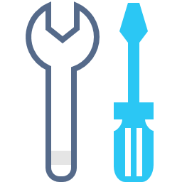

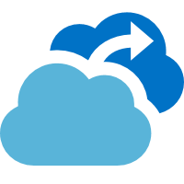
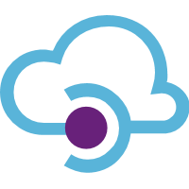
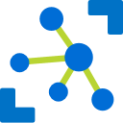
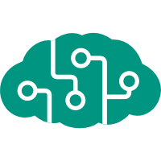
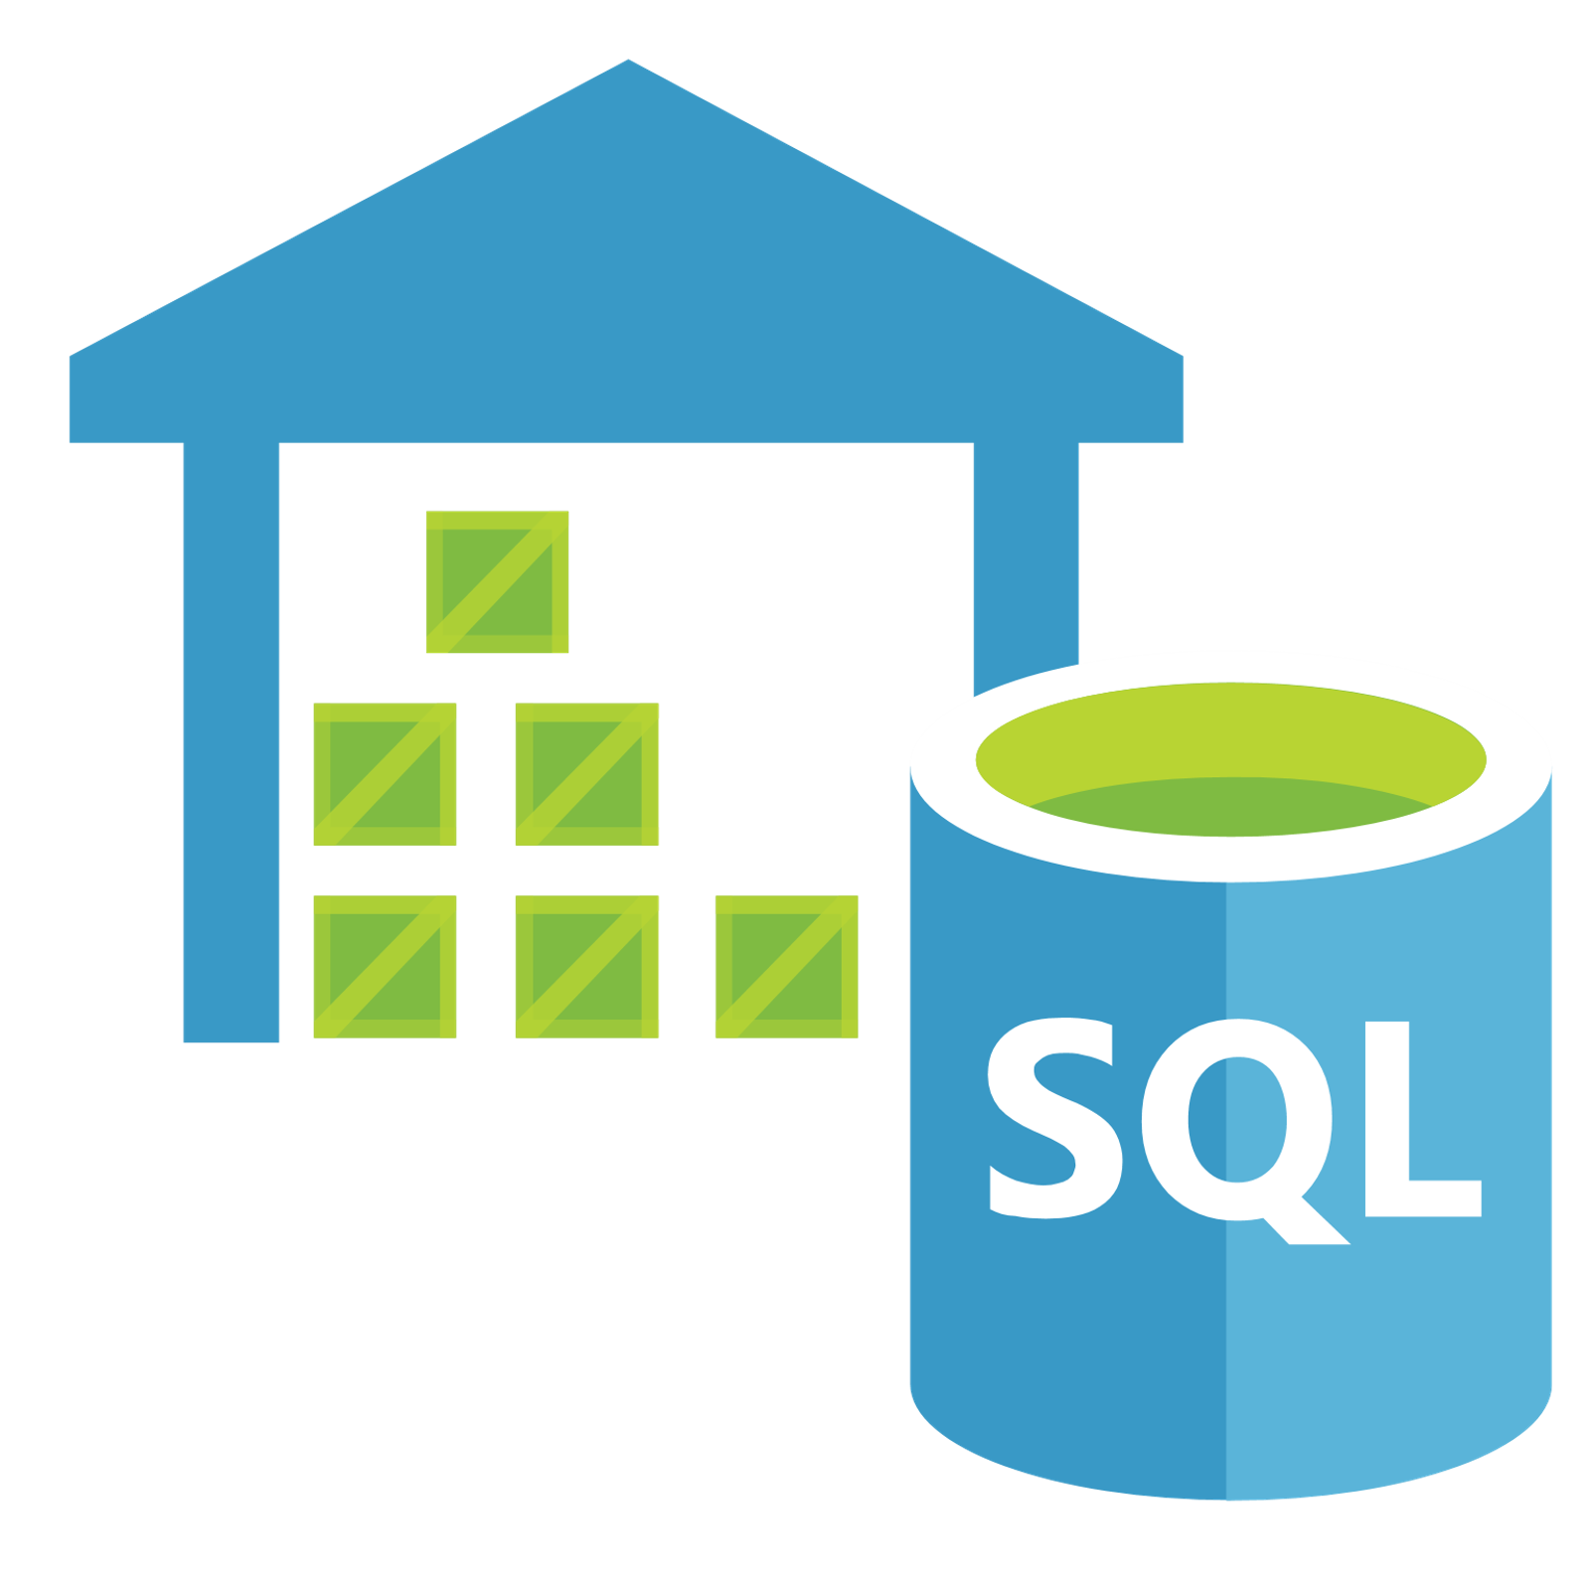
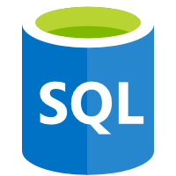

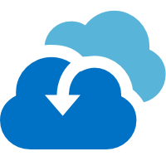

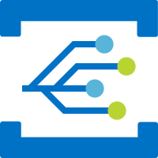


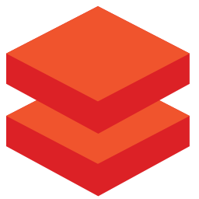
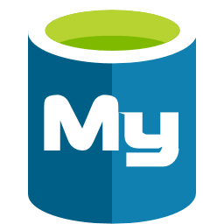


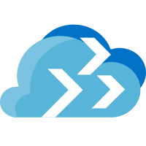


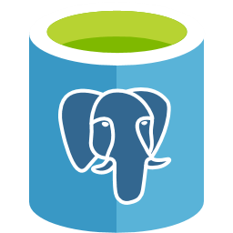


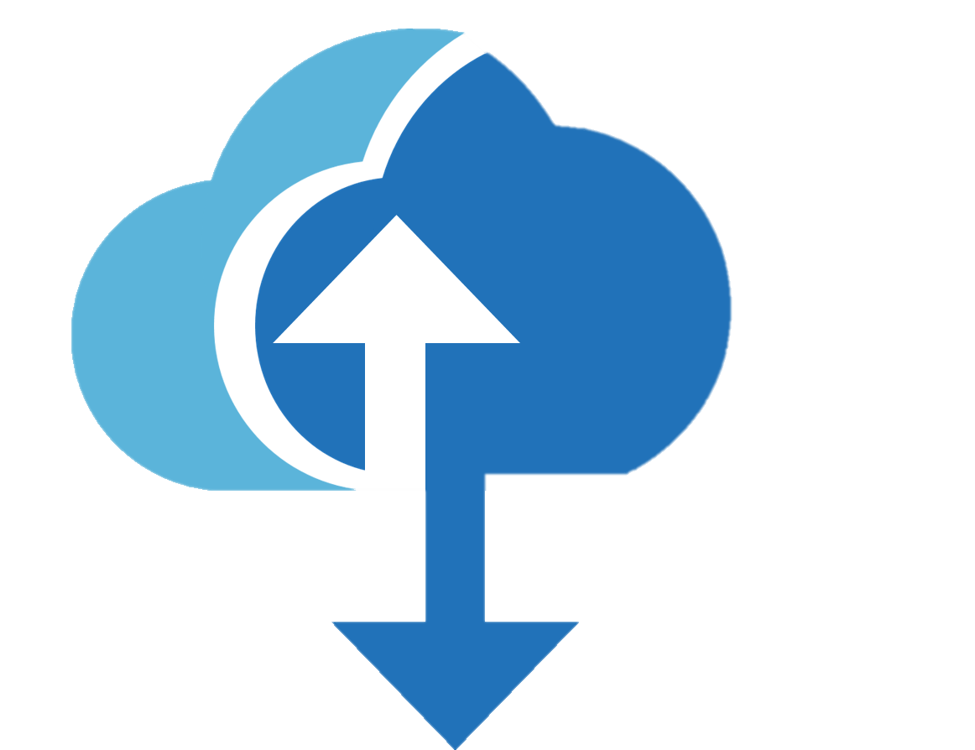


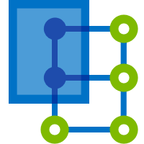

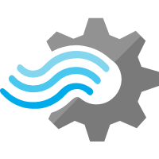

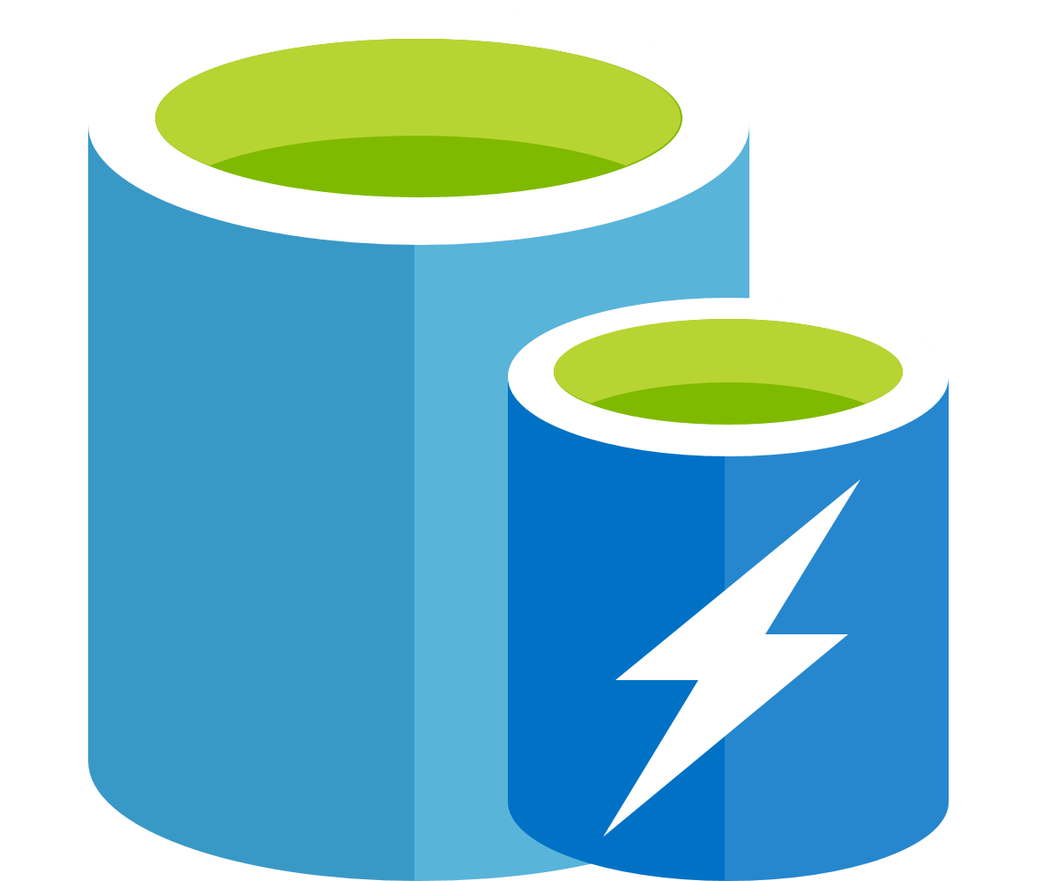


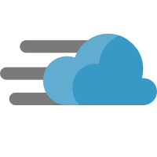
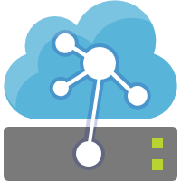

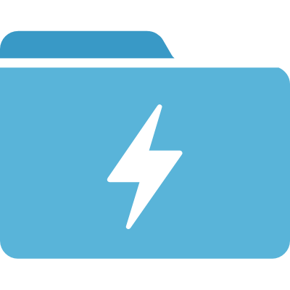

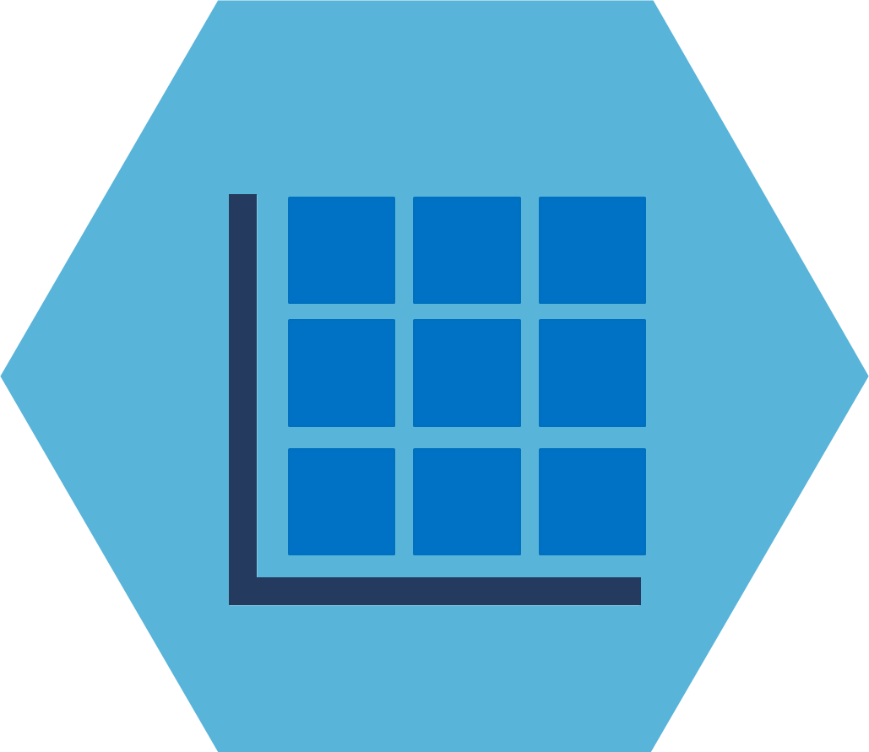
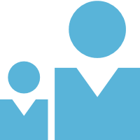
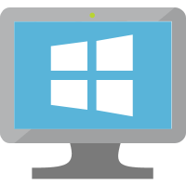

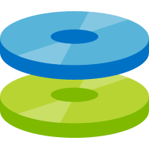
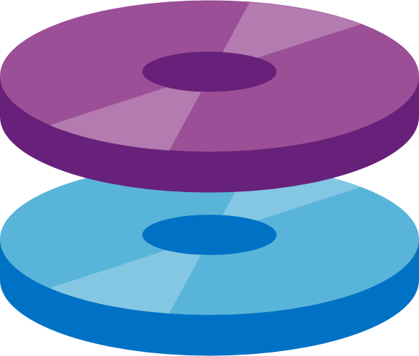
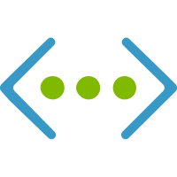

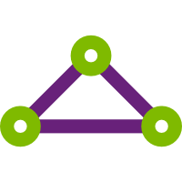
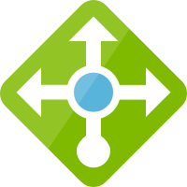
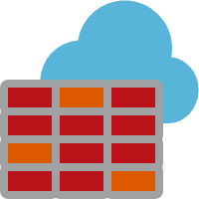
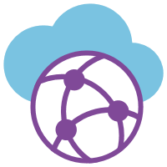

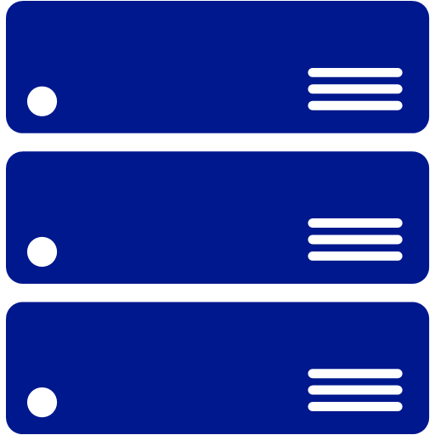
Azure Services
Management
Platform as a Services (PaaS)
Security
Azure
Monitor
Compute/Containers
Web/Mobile
DevOps/Developer
Security
Center
Log
Analytics
Functions
Kubernetes
Service
Web Apps
Logic Apps
API Apps
Azure DevOps
Lab
Services
Azure AD
Azure
Policy
Container
Instance
Service Fabric
Mobile Apps
Notification
Hubs
SignalR
Service
Application
Insights
SDK
Azure AD for
Domain Services
Azure
Bluepirnts
Integration
IoT
AI
Analytics
Data Services
Azure AD
B2C
Azure
Backup
API
Management
Logic Apps
IoT Hub
Cognitive
Services
SQL Data
Warehouse
SQL
Database
SQL Data
Warehouse
DDoS
Protection
Site
Recovery
Service Bus
Event Grid
IoT Central
Machine
Learning Studio
Azure
Databricks
Database for
MySQL
Cosmos DB
Key Vault
Azure
Migrate
Media/CDN
Time Series
Insights
Machine
Learning Service
Apache Spark
Database for
PostgreSQL
Data Factory
Multi-Factor
Authentication
Databox
Family
Media Services
Content
Protection
Azure
Digital Twins
Bot
Services
Stream
Analytics
Database for
MariaDB
Azure Cache
for Redis
Azure ATP
Cost
Management
Video Indexer
Content Delivery
Network
IoT Edge
Azure
Search
Data Lake
Storage Gen2
Database
Migration Service
Table
Storage
Role- based
access control
Infrastructure as a Services (IaaS)
Compute
Storage
Networking
Virtual
Machine Scale Sets
Linux
Virtual
Machine
Disk Storage
Managed
Disks
Virtual
Network
VPN
Gateway
Express
Route
Load
Balancer
Azure
Firewall
Virtual
WAN
Network
Watcher
Azure Datacenter Infrastructure
Notes:
Azure is an big cloud ecosystem with a wide-variety of services.
In this session, we’re going to focus on the App modernization offered by Azure

Slide 18
Azure Services
Platform as a Services (PaaS)
Compute/Containers
Web/Mobile
DevOps/Developer
Functions
Kubernetes
Service
Web Apps
Logic Apps
API Apps
Azure DevOps
Lab
Services
Container
Instance
Service Fabric
Mobile Apps
Notification
Hubs
SignalR
Service
Application
Insights
SDK
Integration
IoT
AI
Analytics
Data Services
API
Management
Logic Apps
IoT Hub
Cognitive
Services
SQL Data
Warehouse
SQL
Database
SQL Data
Warehouse
Service Bus
Event Grid
IoT Central
Machine
Learning Studio
Azure
Databricks
Database for
MySQL
Cosmos DB
Media/CDN
Time Series
Insights
Machine
Learning Service
Apache Spark
Database for
PostgreSQL
Data Factory
Media Services
Content
Protection
Azure
Digital Twins
Bot
Services
Stream
Analytics
Database for
MariaDB
Azure Cache
for Redis
Video Indexer
Content Delivery
Network
IoT Edge
Azure
Search
Data Lake
Storage Gen2
Database
Migration Service
Table
Storage
Notes:
Azure is an enormous cloud ecosystem with a wide-variety of services.
In this session, we’re going to focus on the App modernization offered by Azure

Slide 19
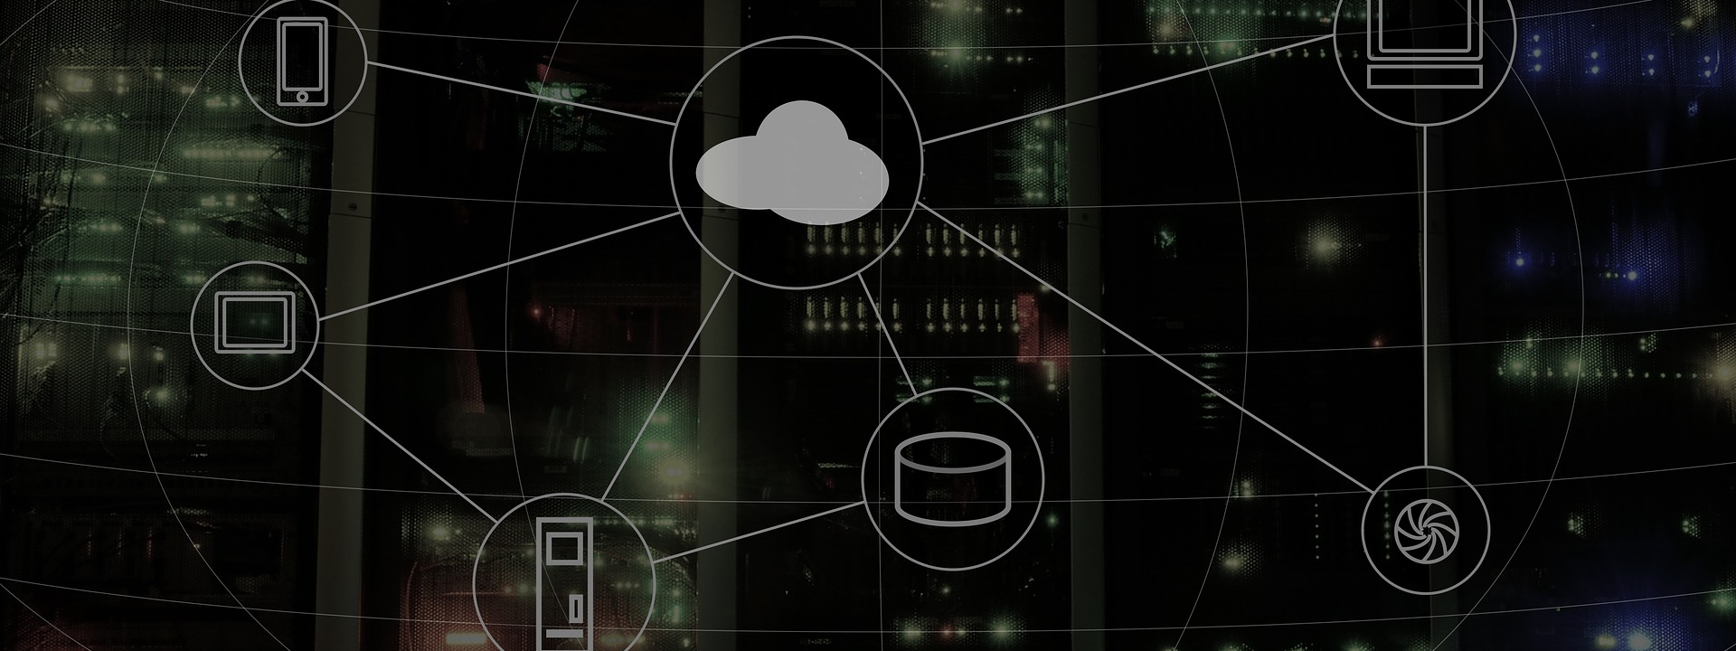
Maturity Model for modernizing .NET applications
Notes:
Now, we will be more specific for .NET application and we will discuss about the Maturity Model for modernize it according to Cloud Model.

Slide 20
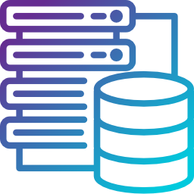
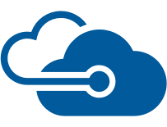






Migration - Lift & Shift - IaaS
Lift & Shift
.NET Web apps (Cloud)
Infrastructure
(as a Service)
On Premises
Traditional Apps
.NET Web application
Applications
Applications
You manage
Data
Data
Runtime
Runtime
On-Premises
IaaS Cloud
Middleware
You manage
Middleware
Relational Database
O/S
Managed by Microsoft
O/S
Virtualization
Virtualization
Servers
Servers
Storage
Storage
Monolithic Architecture
Monolithic Architecture
Networking
Networking
No re-architect, no code changes
Notes:
Traditional Apps Using:
Servers or VMs on-premises
SQL Server, Oracle, MySQL, etc.
Lift & Shift : Virtual Machines (VM)
Azure SQL DB Managed Instance

Slide 21



Cloud Ready - PaaS
On Premises
Traditional Apps
.NET Web application
Lift & Shift
.NET Web apps (Cloud)
Platform
(as a Service)
You manage
Applications
Applications
PaaS Cloud
Data
Data
Runtime
Runtime
On-Premises
Middleware
Managed by Microsoft
You manage
Middleware
O/S
Relational Database
O/S
Virtualization
Virtualization
Servers
Servers
Storage
Storage
Networking
Monolithic Architecture
Networking
No re-architect, no code changes

Slide 22








Cloud Native – Full PaaS
On Premises
Traditional Apps
.NET Web application
Cloud Optimized
.NET Web apps (Cloud)
Platform
(as a Service)
You manage
Applications
Applications
Full PaaS Cloud
Data
Data
Runtime
Runtime
On-Premises
Middleware
Managed by Microsoft
You manage
Middleware
O/S
Relational Database
O/S
Virtualization
Virtualization
Servers
Servers
Storage
Storage
Networking
Monolithic Architecture
Networking
Architected for the Cloud – New Code to adapt
Notes:
Extend your apps with new services based upon Server less computing, Microservices architecture and PaaS services (AppService) to fully exploit the advantages of the cloud.

Slide 23











Azure Database Migration Service
On-Premises
Microsoft Azure
Assessment
SSMA & DMA
Azure Database Migration Service
SGBDR Or NoSQL
Azure Database

Slide 24



.NET migration alternative and choice
Azure App Service
Azure Virtual Machines
.NET Application
MVC App
Web Forms App
NO
Dependencies
Web API service
Windows containers on Azure VMs
YES
Windows Containers on Azure Container
Services (ACS)
SignalR service
YES
Migration Process?
NO
Windows Containers on Azure Service
Fabric
Web Pages App
WCF service
Notes:
.NET application can be MVC app any version 4 or 5, web forms app, web API service any version, Web Pages app or WCF service, if you have dependencies that can be documents, file system, COM-objects,…you need to pass by migration process, defined in vision architecture, and we decide to move them with the environment on VM lift and shift or we can move them in windows containers on Azure VMs, or on Azure Container Service or Azure Service Fabric. While containers support a quick migration path, since no code needs to be changed, it has a more complex learning curve than migration to Azure VMs
If no dependencies, it will be more simple to use Azure App Service, or Azure Container Instance.

Slide 25
Windows Containers are a strategic way to modernize your existing .NET Framework applications

Slide 26

How do containers help in app modernization?

Slide 27
































“The Application works in localhost machine!...
But not in production?”
“Use a container like Docker, dev environment is similar to production environment”
Notes:
Containers give developers the ability to create predictable environments, isolated from other applications.
Every dependency needed by the application, versions of the runtime, libraries etc., are included in the container and guaranteed to be consistent regardless of where the image is deployed
This equals productivity. Developers and Ops teams spend less cycles debugging or diagnosing environment issues and more time pushing features and enhancements to the users.

Slide 28



Containers
<On-premises>
<Re-host>
<re-factoring>
<Re-architecting>
App
Container
Container
App
App
Binaries & Libraries
Container
Container
Guest VM
OS
App
App
Existing or New Apps
Lift and shift to containers
Microservices
Notes:
If we come back to our 5R for containers, we can see how we can deploy if we want to rehost, or refactor and the microservice approach if we decide to rearchitect and for new application we have to build patterns to adopt cloud native strategy in the future.

Slide 29





Containers in Azure: a complete Set of Choices
App Service
Service Fabric
Kubernetes Service
Container Instances
Batch
Notes:
Azure provides different choices for app modernization

Slide 30







Container running on Azure
App Service
Service Fabric
Kubernetes Service
Container Instance
Ecosystem Partner
Deploy web applications or Web APIs in a PaaS environment
Modernize .NET applications in microservices using Windows Server
Orchestrate and scale the Linux or Windows Containers
Easily run containers on Azure without managing servers
Bring your partner solutions that work perfectly on Azure
Azure Container Registry
Docker Hub
Choice of developer tools and clients
Notes:
Azure natively provides several Container services and orchestrators

Slide 31






Orchestrators in Azure
Azure Product
Orchestrator / Engine | Description | Good for | Common workloads
 | Kubernetes is an open-source platform for automating deployment, scaling, and operations of application containers across clusters of hosts. AKS: You pay for VMs in cluster ACS Engine: IaaS container infrastructure |  | Microservices based on containers
 | Azure Service Fabric is a distributed systems platform that makes it easy to package, deploy, and manage scalable and reliable microservices. Mesh: PaaS/Serverless platform Cluster: You pay for VMs in cluster |  | Microservices based on containers Microservices based on plain processes Stateful services
Kubernetes
It’s an OSS ecosystem
Azure Kubernetes Service
(AKS)
More mature:
Less mature:
Service Fabric
Azure Service Fabric
(Mesh and cluster)
It’s a Microsoft ecosystem
and OSS
More mature:
Less mature:

Slide 32


From container to Orchestrator
Development and
Deployment technologies
Cloud infrastructure and
Some Orchestrators
Azure Container Service
Mesos DC/OS
Kubernetes
Docker Swarm
.NET Framework
.NET Core
Orchestrators
Dev environment
Azure Service Fabric
BLOB Storage
Service Bus
SQL Database
Docker Containers
Cloud
Infrastructure
Production environment
Deployment
environment
Cosmos DB
Redis Cache
Key Vault
Architecture/Design/Development
Infrastructure Decisions
Production-Ready Microservices

Slide 33


Prerequisites Environment
Windows 10 is required for Docker installation.
Visual Studio 2019 or 2017 has built-in support for Docker
.NET Core SDK
Docker for Windows
Docker Tools

Slide 34



Deploy a Modern Applications for Azure Kubernetes Service (AKS)
Create and Push images
with docker desktop
Commit Azure Repos
and build Docker images
Push Docker images to
Azure container registry
or Docker Hub
Deploy to AKS

Slide 35


Q&A
Guide to migrate your .NET app to Azure
Hamida REBAÏ
@rebaihamida
didourebai@gmail.com

